Slide 1

Library Management System in c
presenting by
P .Hema(aids-b)
24kb1a3083
n.b.k.r.institute of science and technology

Slide 2
Intorduction
What is a library management system?
A program to manage books in a library
Features included:
1. Adding and removing Books
2.Books issue and returning details
3. searching for book is the book is present or not

Slide 3
Linked List for Book Management
Here we consider Each book is a node in a linked list
customization of Book Structure:
a. int id
b. char title[100]
c. char author[100]
d. int isIssued(0=available, 1=issued)
e.Book *next (pointer to the next book)

Slide 4
Over view of Main Functions
addbook() - Adds a New book
removeBook() - Deletes a book by ID
searchBook() - Finds a book by ID
issueBook() - Marks a book as issued
returnBook() - Marks a book as returned
displayBooks() - Shows all books

Slide 5
Adding a New Book
Takes book ID , title and author name
Creates a node and adds to the list head
Uses createBook() function
Checks memory allocation
Gives information as Book was added

Slide 6
Removing a book
Takes book ID
Searches for the book in the list
Removes node and free memory
Handles case when book not found
Gives information as Book not found

Slide 7
Book Operation
Search Book: Finds by ID and shows info
Issue Book : Sets isIssued=1
Return Book : Sets isIssued=0
All search the list for the matching ID

Slide 8
Displaying All Books
Iterates through the list
Prints ID , Title , author and Status
shows “issued” or “Available”

Slide 9
User Menu in main( ) Function
Runs in a loop until exit
User selects option (1-6 or 0)
Calls corresponding functions by given number

Slide 10
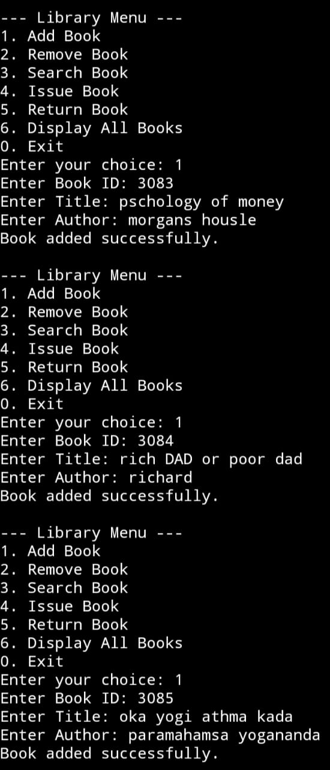
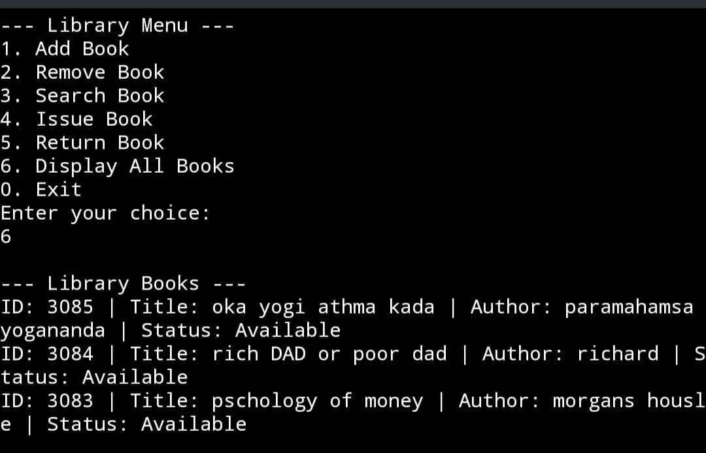
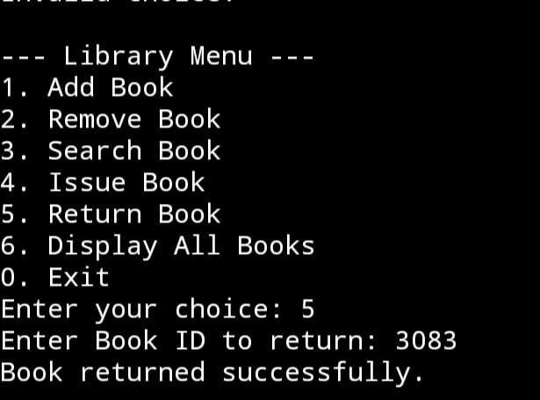
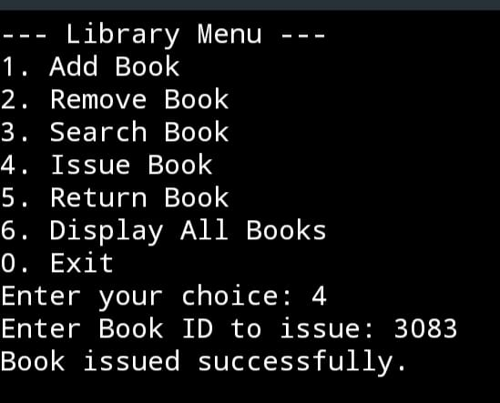
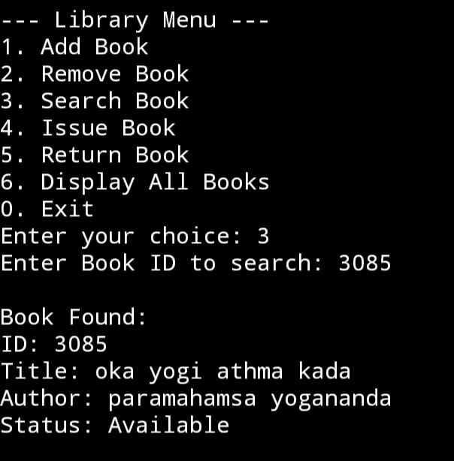
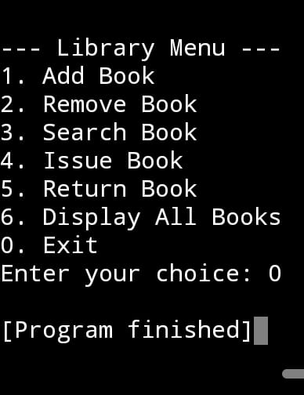
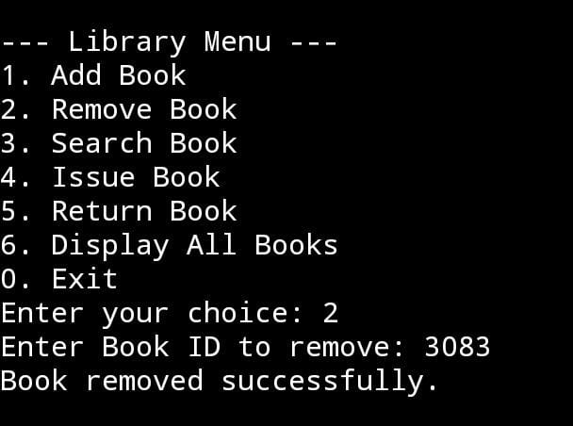
Notes:
m

Slide 11
Conclusion
The project demonstrates how a library management system can be developed with basic
C programming. It allows users to add,remove,search,issue and return books as well as display
All available books .The system provides basic functionality for managing a library’s book
collection . The program can be easily understandable to learner this code was developed with
Structures and linked list .By searching for any book we can get information like book code,
Book name, author name and is the book available at the library or not. Futures need to this code is book categories(non-fiction or fiction),online access ,book reservation, search by author.

Slide 12
Thank you
Thank you for giving this opportunity to respected faculty

